Slide 1
Linux & Shell
Lecturer：Professor Pao-Ann Hsiung
Teaching Assistant:鐘翊誠& 龔惠俊
Embedded Systems Laboratory National Chung Cheng University

Slide 2
OutLine
1. Introduction to Linux
2. How to connect with Linux work station
3. Basic Linux commands
4. Shell
5. Demo

Slide 3
1. Introduction to Linux
Linux is an operating system or a kernel. It is distributed under an open source license. Its functionality list is quite like UNIX.
- Linux is the OS of choice for Server environments due to its stability and reliability.
- Can be installed in a variety of computer hardware devices, from mobile phones, tablets, routers and video game consoles, to desktop computers, large computers and supercomputers
- Anyone and organization can freely use all of the underlying source code of Linux as long as they follow the GNU General Public License, and can freely modify and redistribute it.
Notes:
Linux now enjoys popularity at its prime, and it's famous among programmers as well as regular computer users around the world.

Slide 4
1. Introduction to Linux
Install prerequisites
→ Native installation:
PC installed Linux, can be graphical interface (GUI, Graphic User Interface) or Shell command line (Shell Command Line)
→ Remote operation:
PCs can be connected to a server with Linux via a remote connection.

Slide 5
2. How to connect with Linux work station
Putty and Pietty
- Small and convenient Telnet/SSH secure remote with threaded, formerly Putty, but later expanded to Pietty due to language support
Workstation
Linux | FreeBSD
tux.cs.ccu.edu.tw | daemon.cs.ccu.edu.tw

Slide 6
2. How to connect with Linux work station
Open Putty or Pietty
Enter server name:
Server: <資工系系上工作站>
Enter workstation account password
My classmates: My own account
Foreign students: Last week, there was a unified application for students who did not have an account. Please check the mail box of the application form for checking.

Slide 7
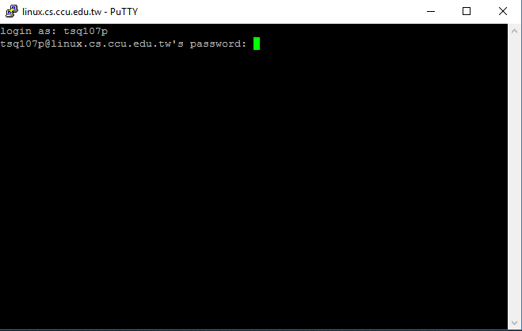
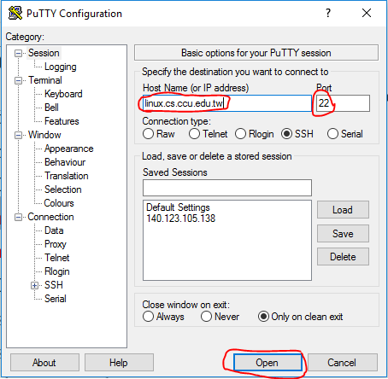
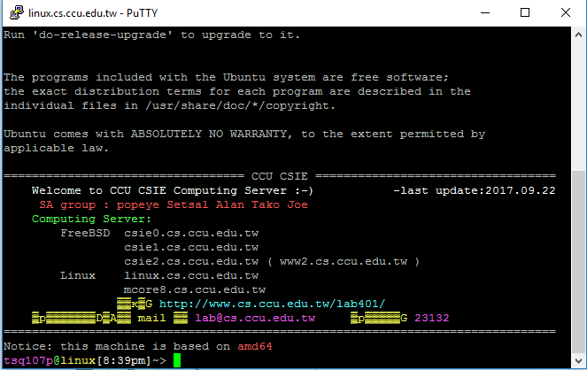
2. How to connect with Linux work station

Slide 8
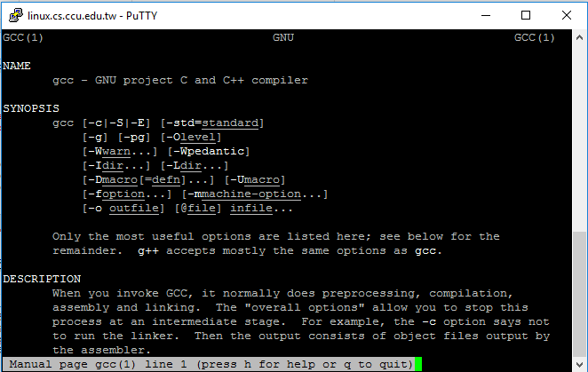
3. Basic Linux commands
Instruction name: man (Manual pager utils)
Purpose: View instructions usage, functions, options, etc.
Use: man [query command name]
Example: man gcc
Search : /<search target>
Quit: q

Slide 9
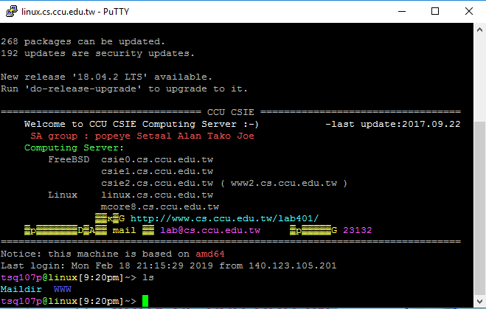
3. Basic Linux commands
Instruction name: ls (List)
Purpose: View all current files

Slide 10
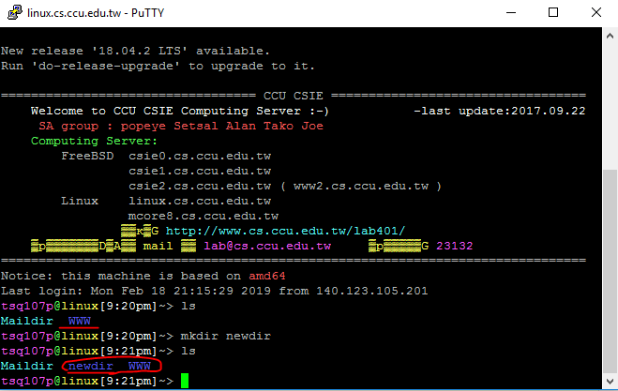
3. Basic Linux commands
Instruction name: mkdir (make directory)
Purpose: Create a new air folder
Use: mkdir [directory name]
Example: mkdir newdir

Slide 11

3. Basic Linux commands
Instruction name: cd (change direction )
Purpose: Switch folders
Use: cd [Folder path]
Example:
- cd newdir (Enter the newdir folder)
- cd ~ (Enter the home directory)
- cd .. (Back to the previous directory)

Slide 12
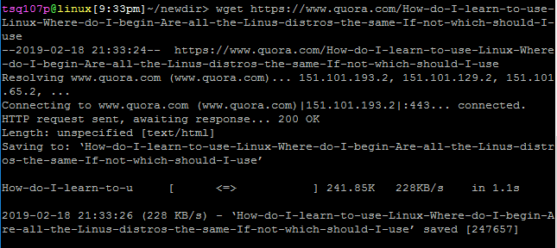
3. Basic Linux commands
Instruction name: wget
Purpose: to obtain web page information
Use: wget [url]
Example: wget https://www.quora.com/How-do-I-learn-to-use-Linux-Where-do-I-begin-Are-all-the-Linus-distros-the-same-If-not-which-should-I-use

Slide 13
3. Basic Linux commands
Instruction Name : gcc (gcc(GNU Compiler Collection)
Purpose : Compiler
Use : gcc [parameter (optional)] [file to be compiled]
Example 1: gcc test.c
If the output file name is not set, the file name is automatically set to a.out.
Example 2: gcc –o test test.c
-o : followed by the executable file name to be output
→ Question: How to execute the compiled executable file?
→ ANS: Put the name of the executable file after ./! Ex : ./test

Slide 14
3. Basic Linux commands
.
:
Instruction name : rm (remove or delete)
Purpose : Delete files
Use :
To delete a single file use, the rm command followed by the file name: rm [filename]
Use the -i option to confirm each file before deleting it: rm -i [filename(s)]
To remove all .txt files in the current directory without a prompt in verbose mode, use the following command: rm –f [name file].txt
Remove an empty directory use the -d option: rm -d [dirname]
To remove non-empty directories and all the files within them, use the r (recursive) option: rm -r dirname
Example :

Slide 15
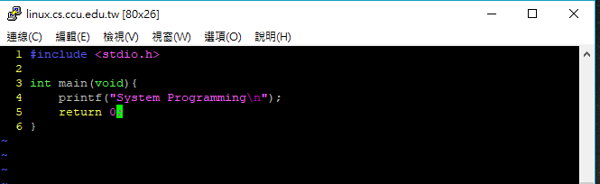
3. Basic Linux commands
Instruction name: vim
Purpose: Write and view files (if the file does not exist, open a new file)
Use: vim [archive]
Example: vim test.c

Slide 16
3. Basic Linux commands
Instruction name: vim
How to use:
- Function: Move cursor, delete character, copy paste, etc., can't input message
Example: u (restore), ctrl+r (redo), dd (delete an entire line)…
Vim has two mode:
1. Edit mode
Function: Text editing
Entry mode: Press "a, i, o, r" in the normal mode to enter the edit mode. Press ESC in edit mode to return to the normal mode.
2. Command mode
Function: Perform instruction actions such as reading, archiving, leaving, etc.
Access method: Enter ":<instruction>" in normal mode
Example: :w (archive): q (away) :wq (left after archiving) :q! (not archived away)

Slide 17

3. Basic Linux commands
Instruction name : make (make file)
Purpose: Help us quickly compile through prior settings
Use : make

Slide 18
3. Basic Linux commands
指示Makefile如何進行編譯的規則，主要語法:
target: 要建立的檔案，需以冒號結尾。
dependecies: 相依項目，根據此項決定是否重新編譯target，如果此項的修改日期比target新，則重新編譯。
commands: 用來建立target的指令，必須以<TAB>開頭。
target: dependencies
<TAB> commands

Slide 19
3. Basic Linux commands
all: hello.c
gcc –o hello hello.c
TARGET=shell
$(TARGET): fig1_10.o error.o
$(CC) -o $@ $^
fig1_10.o: fig1_10.c
error.o: error.c
clean:
rm -f fig1_10.o error.o $(TARGET)

Slide 20
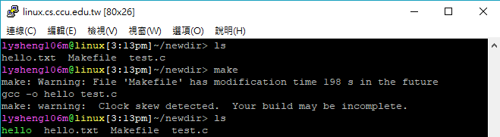
3. Basic Linux commands
Makefile
all: hello.c
gcc –o hello hello.c

Slide 21
Reference
Linux:
http://zh.wikipedia.org/wiki/Linux
Vim:
http://linux.vbird.org/linux_basic/0310vi.php
Makefile
http://www.gnu.org/savannah-checkouts/gnu/make/manual/html_node/index.html
http://www.study-area.org/cyril/opentools/opentools/makefile.html
http://mropengate.blogspot.tw/2018/01/makefile.html

Slide 22
Shell

Slide 23
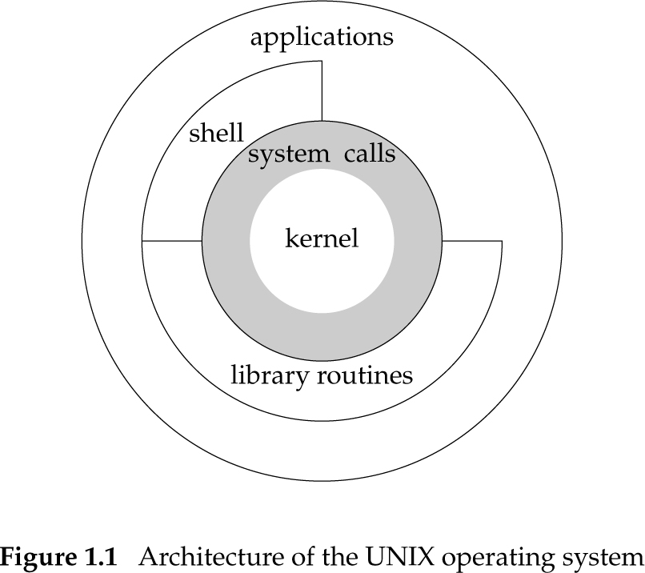
Shell Review

Slide 24
fork()
呼叫fork()之後，會複製一份與呼叫程式相同的程式，並且那份程式會從呼叫的當行繼續往下執行。
Process
Process ID(Pid)
Call fork()
Parent
Child
收到回傳的Pid = chid 的 pid(大於0的值)
收到回傳的Pid = 0 (自己的pid=0)

Slide 25
fork()
#include<stdio.h>
#include<unistd.h>
int main()
{
pid_t pid;
pid=fork();
printf(“pid=%d\n”,pid);
return 0;
}

Slide 26
fork()
#include<stdio.h>
#include<unistd.h>
int main()
{
pid_t pid;
pid=fork();
printf(“pid=%d\n”,pid);
return 0;
}

Slide 27
fork()
#include<stdio.h>
#include<unistd.h>
int main()
{
pid_t pid;
pid=fork();
printf(“pid=%d\n”,pid);
return 0;
}
#include<stdio.h>
#include<unistd.h>
int main()
{
pid_t pid;
pid=fork();
printf(“pid=%d\n”,pid);
return 0;
}

Slide 28
fork()
#include<stdio.h>
#include<unistd.h>
int main()
{
pid_t pid;
pid=fork();
printf(“pid=%d\n”,pid);
return 0;
}
#include<stdio.h>
#include<unistd.h>
int main()
{
pid_t pid;
pid=fork();
printf(“pid=%d\n”,pid);
return 0;
}
pid=12345678
pid=0

Slide 29
fork()
#include<stdio.h>
#include<unistd.h>
int main()
{
pid_t pid;
pid=fork();
printf(“pid=%d\n”,pid);
printf(“parent\n”);
printf(“child\n”);
return 0;
}
#include<stdio.h>
#include<unistd.h>
int main()
{
pid_t pid;
pid=fork();
printf(“pid=%d\n”,pid);
printf(“parent\n”);
printf(“child\n”);
return 0;
}

Slide 30
fork()
#include<stdio.h>
#include<unistd.h>
int main()
{
pid_t pid;
pid=fork();
printf(“pid=%d\n”,pid);
printf(“parent\n”);
printf(“child\n”);
return 0;
}
#include<stdio.h>
#include<unistd.h>
int main()
{
pid_t pid;
pid=fork();
printf(“pid=%d\n”,pid);
printf(“parent\n”);
printf(“child\n”);
return 0;
}
pid=12345678
parent
child
pid=0
parent
child

Slide 31
fork()
#include<stdio.h>
#include<unistd.h>
int main()
{
pid_t pid;
pid=fork();
printf(“pid=%d\n”,pid);
if(pid>0)
printf(“parent\n”);
else if(pid==0)
printf(“child\n”);
return 0;
}
#include<stdio.h>
#include<unistd.h>
int main()
{
pid_t pid;
pid=fork();
printf(“pid=%d\n”,pid);
if(pid>0)
printf(“parent\n”);
else if(pid==0)
printf(“child\n”);
return 0;
}

Slide 32
fork()
#include<stdio.h>
#include<unistd.h>
int main()
{
pid_t pid;
pid=fork();
printf(“pid=%d\n”,pid);
if(pid>0)
printf(“parent\n”);
else if(pid==0)
printf(“child\n”);
return 0;
}
#include<stdio.h>
#include<unistd.h>
int main()
{
pid_t pid;
pid=fork();
printf(“pid=%d\n”,pid);
if(pid>0)
printf(“parent\n”);
else if(pid==0)
printf(“child\n”);
return 0;
}
pid=12345678
parent
pid=0
child

Slide 33
fork()
由於fork出來的子程序會與父程序同步執行，事實上你有可能會看到:
或者:
pid=12345678
pid=0
parent
child
pid=12345678
pid=0
child
parent

Slide 34
waitpid ()
表頭文件:
#include<sys/types.h>
#include<sys/wait.h>
定義函數 : pid_t waitpid(pid_t pid,int * status,int options);
程式碼中出現waitpid (pid,&status,0)時，該程序便會停在那一行等編號pid的程序完成才會繼續往下一行執行

Slide 35
waitpid ()
#include<stdio.h>
#include<unistd.h>
int main()
{
pid_t pid;
pid=fork();
if(pid>0){
waitpid (pid,0,0);
printf(“parent\n”);
}
else if(pid==0)
printf(“child\n”);
return 0;
}
#include<stdio.h>
#include<unistd.h>
int main()
{
pid_t pid;
pid=fork();
if(pid>0){
waitpid (pid,0,0);
printf(“parent\n”);
}
else if(pid==0)
printf(“child\n”);
return 0;
}

Slide 36
waitpid ()
#include<stdio.h>
#include<unistd.h>
int main()
{
pid_t pid;
pid=fork();
if(pid>0){
waitpid (pid,0,0);
printf(“parent\n”);
}
else if(pid==0)
printf(“child\n”);
return 0;
}
#include<stdio.h>
#include<unistd.h>
int main()
{
pid_t pid;
pid=fork();
if(pid>0){
waitpid (pid,0,0);
printf(“parent\n”);
}
else if(pid==0)
printf(“child\n”);
return 0;
}
child

Slide 37
waitpid ()
#include<stdio.h>
#include<unistd.h>
int main()
{
pid_t pid;
pid=fork();
if(pid>0){
waitpid (pid,0,0);
printf(“parent\n”);
}
else if(pid==0)
printf(“child\n”);
return 0;
}
#include<stdio.h>
#include<unistd.h>
int main()
{
pid_t pid;
pid=fork();
if(pid>0){
waitpid (pid,0,0);
printf(“parent\n”);
}
else if(pid==0)
printf(“child\n”);
return 0;
}
parent
child

Slide 38
waitpid ()
所以你會看到:
而不至於亂序變成:
child
parent
parent
child

Slide 39
Figure 1.10
Read commands from stdin and than execute

Slide 40
Figure 1.10
#include “apue.h"
#include <sys/wait.h>
static void sig_int(int); /* our signal-catching function */
int main(void)
{
char buf[MAXLINE];
pid_t pid;
int status;
if (signal(SIGINT, sig_int) == SIG_ERR)
err_sys("signal error");
printf("%% "); /* print prompt (printf requires %% to print %) */
while (fgets(buf, MAXLINE, stdin) != NULL) {
if (buf[strlen(buf) – 1] == ‘\n’)
buf[strlen(buf) - 1] = 0; /* replace newline with null */

Slide 41
Figure 1.10
if ( (pid = fork()) < 0)
err_sys("fork error");
}else if (pid == 0) { /* child */
execlp(buf, buf, (char *) 0);
err_ret("couldn't execute: %s", buf);
exit(127);
}
/* parent */
if ( (pid = waitpid(pid, &status, 0)) < 0)
err_sys("waitpid error");
printf("%% ");
} /* end while*/
exit(0);
}
void
sig_int(int signo)
{
printf("interrupt\n%% ");
}
子程序 (執行命令)
父程序 (等待子程序執行結束)

Slide 42
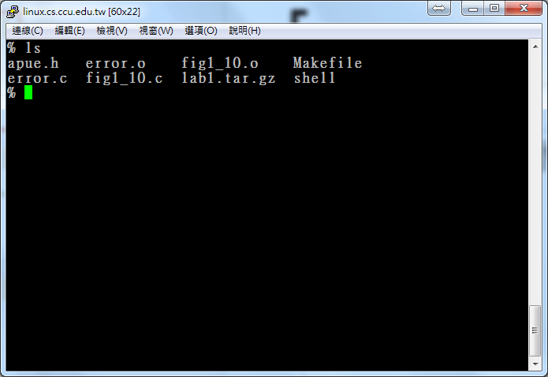
Figure 1.10

Slide 43
程式範例
下載檔案
Ecourse2上
解壓縮檔案
$unzip Lab1.zip
編譯程式碼
$make
執行程式
$./shell

Slide 44
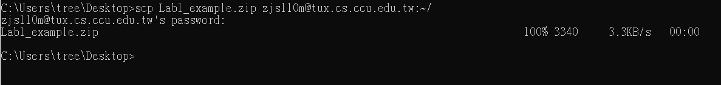
將檔案傳到工作站(可選)
如果想使用資工系工作站，請先下載好Lab1_example.zip ，windows 10上打開cmd.exe
使用cd 切換到檔案所在目錄(下圖是放在桌面)
輸入 scp Lab1_example.zip 帳號@tux.cs.ccu.edu.tw:~/
enter後，會要求輸入工作站密碼(輸入的密碼不會顯示在畫面上) ，輸入完再次enter後，即可傳送壓縮檔到工作站，解壓縮的方法和前張投影片相同

Slide 45
程式範例
Lab1.zip:
Lab1/
apue.h
error.c
fig1_10.c
Makefile

Slide 46
Tips
fig1_10.c內使用execlp，沒有完善的把他建構起來，所以無法良好作用(只能使用無參數的指令)，可以參考execvp指令
使用範例
#include<unistd.h>
main()
{
char * argv[ ] ={ “ls”,”-al”,”/etc/passwd”,0};
execvp(“ls”,argv);
}

Slide 47
Tips
假設buf = “ls –al /etc/passwd”
需要把buf拆分成三個字串:
argv[0]=“ls”
argv[1]=“-al”
argv[2]=“/etc/passwd”
才能餵給execvp
可參考string.h中的function(strcmp strtok等)做字串處理，將你輸入的字串做比對或拆解。

Slide 48
Tips
使用chdir(directory)進行切換目錄
如果輸入cd指令，則不進行fork，直接進行chdir(directory)

Slide 49
Reference
Linux C常用語法http://people.cs.nctu.edu.tw/~yslin/library/linuxc/main.htm
Advanced Programming in the UNIX® Environment
http://www.apuebook.com/

